Slide 1

Introduction to Databases
By Mehdi Sassi

Slide 2
What is a RDBMS ?
RDBMS (Relational DataBase Management System)
RDBMS is a collection of programs and capabilities that enable IT teams and others to create, update, administer and otherwise interact with a relational database.
RDBMSes store data in the form of tables, with most commercial relational database management systems using Strucured Query Language (SQL) to access the database

Slide 3
Now we'll see the 3 well known relational RDBMS
MySQL
PostgreSQL
SQL Server

Slide 4
MySQL
MySQL is an open-source relational database management system (RDBMS).
It was created by a Swedish company in 1994.
MySQL is used to manage the data of web applications, websites, and even mobile applications by sorting it into tables; because of this, it is called a relational database.

Slide 5
PostgreSQL
PostgreSQL is a powerful, open source object-relational database system that uses and extends the SQL language combined with many features that safely store and scale the most complicated data workloads.
The origins of PostgreSQL date back to 1986 as part of the POSTGRES project at the University of California at Berkeley
PostgreSQL is used as the primary data store or data warehouse for many web, mobile, geospatial, and analytics applications. The latest major version is PostgreSQL 12.

Slide 6
SQL Server
SQL Server is a elational database management system developed by Microsoft
The history of Microsoft SQL Server begins in 1989 and extends to the current day.
As a databse server, it is a software product with the primary function of storing and retrieving data as requested by other software applications.

Slide 7
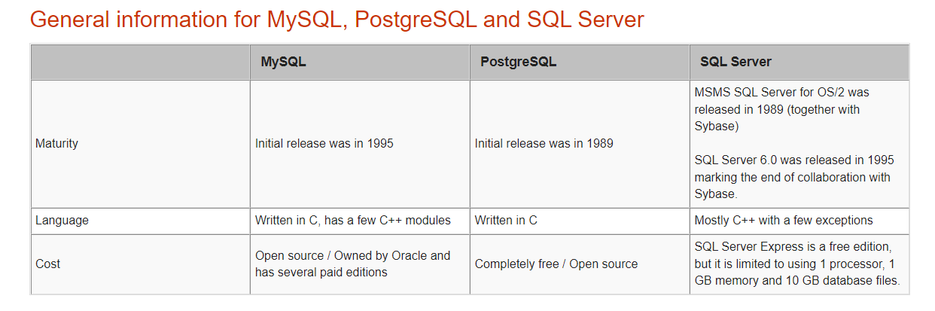
Comparison between the 3 RDBMS

Slide 8
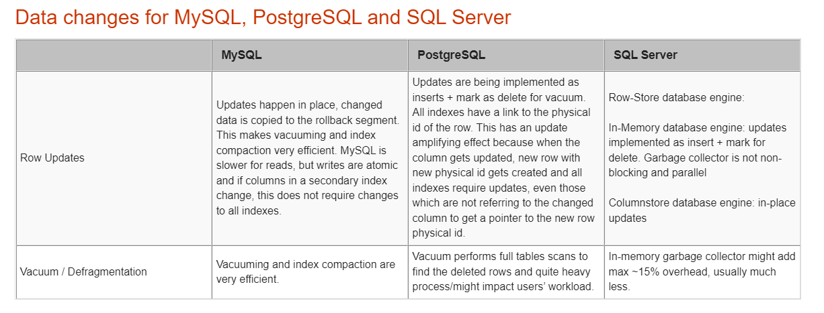
Comparison between the 3 RDBMS

Slide 9

Thank you

